Slide 1
Location based Services

Slide 2
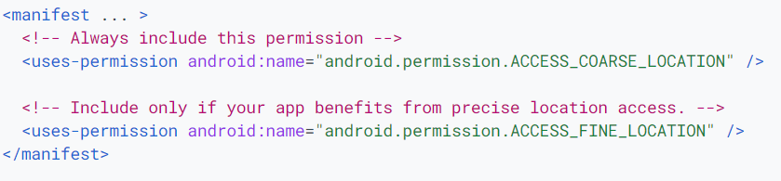
Request location permissions
Foreground location
Shares or receives location information only once, or for a defined amount of
time
Example: navigation app, a feature allows users to get turn-by-turn directions

Slide 3
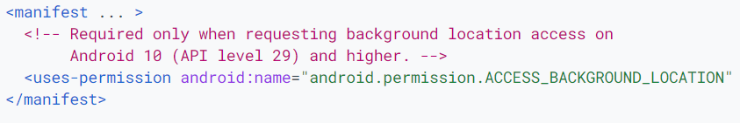
Request location permissions
Background location
Feature within the app constantly shares location with other users or uses the Geofencing API
Examples: Family location sharing app, IoT app

Slide 4
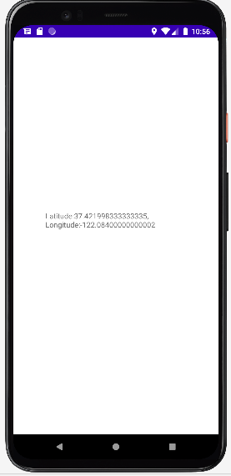

Slide 5
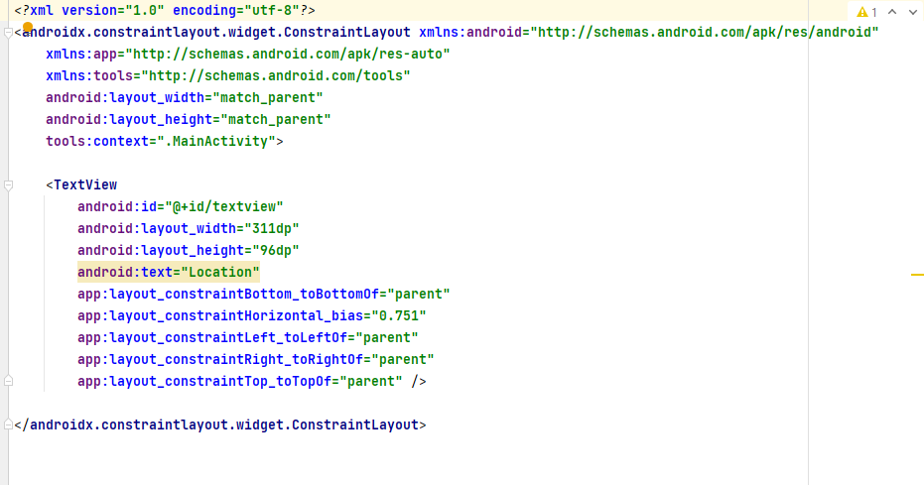
activity_main.xml

Slide 6
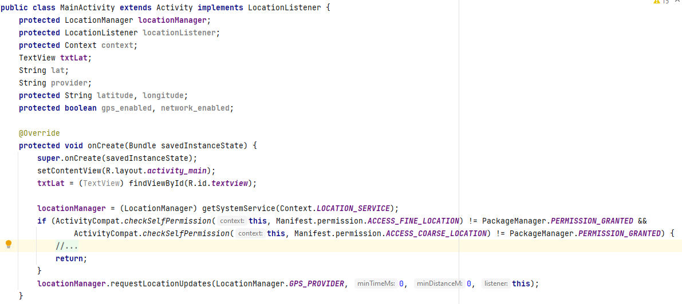
MainActivity.java

Slide 7
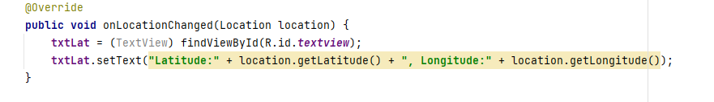
MainActivity.java cntd…

Slide 8
Text to Speech

Slide 9
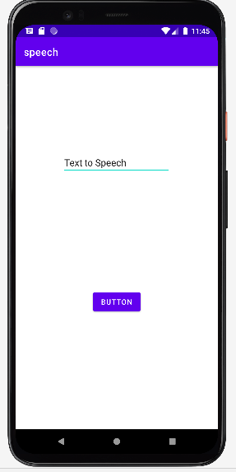

Slide 10
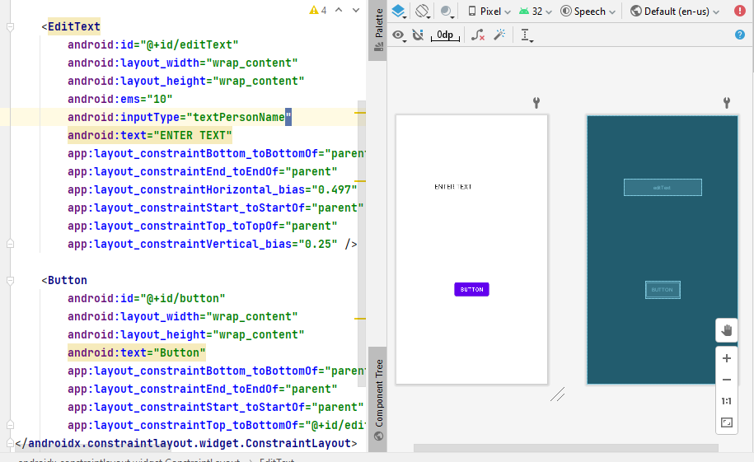
activity_main.xml

Slide 11
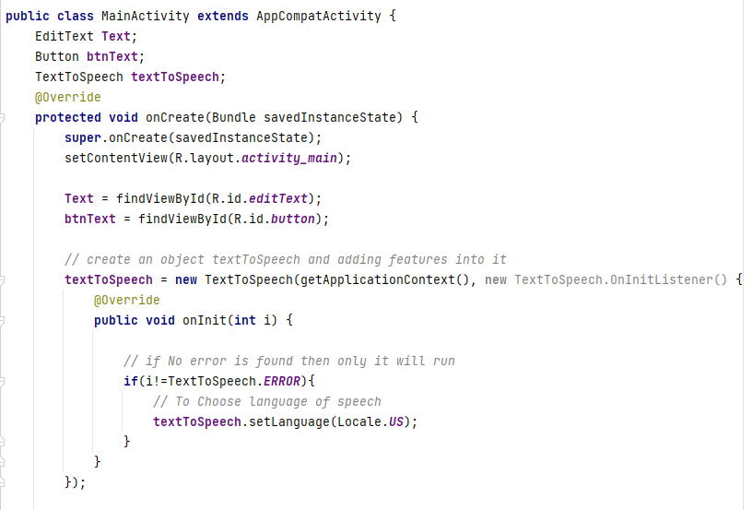
MainActivity.java

Slide 12
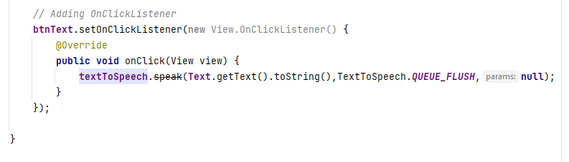
MainActivity.java contd…

Slide 13
Call to a Number

Slide 14
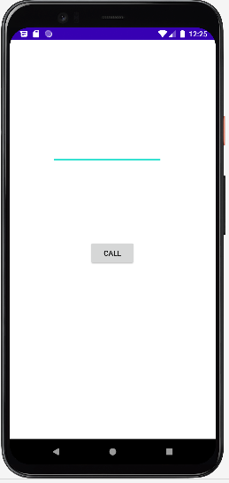
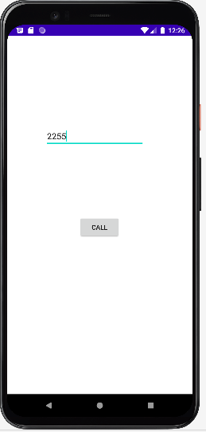

Slide 15
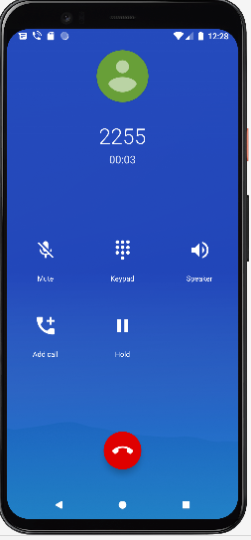

Slide 16
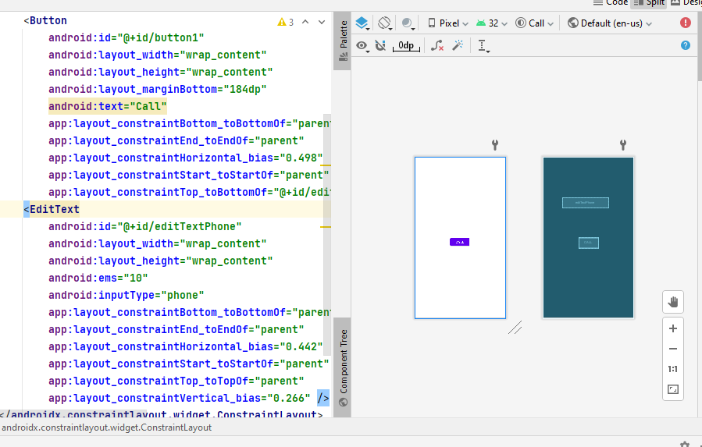
activity_main.xml

Slide 17
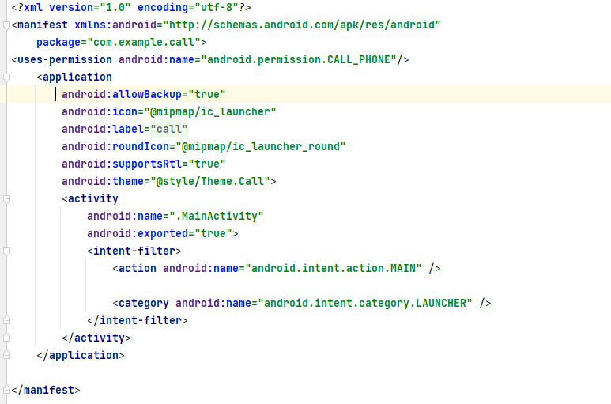
AndroidManifest.xml

Slide 18
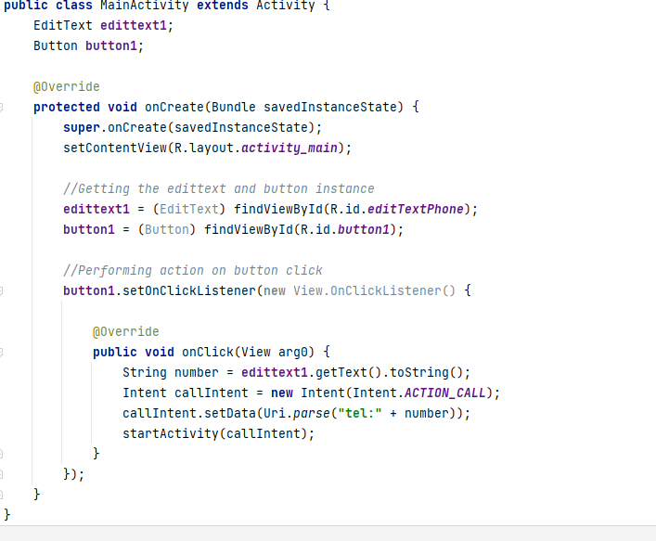
MainActivity.java contd…

